Slide 1
Dependent Motion Analysis
Dr. Jacob Moore
Associate Professor of Engineering
Penn State Mont Alto

Slide 2
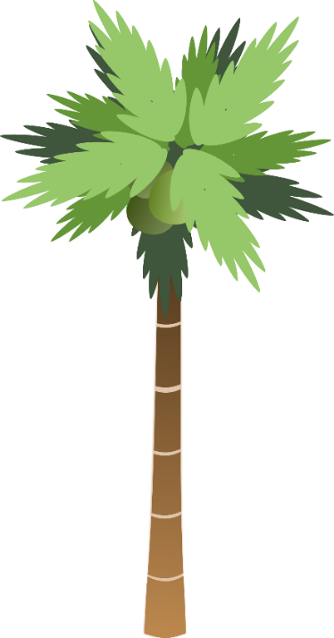

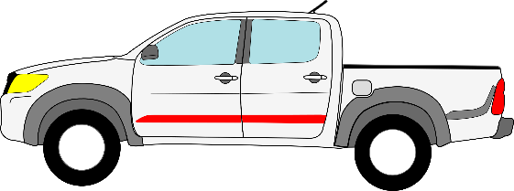
Dependent Motion
In many situations, the motion of one object is directly related to the motion of another object through a constraint.
Below is an example, the fixed length of the rope is the constraint relating the motion of the SUV to the motion of the truck
20 ft
10 ft

Slide 3
Dependent Motion
Assuming we know the velocity of the small SUV, could we predict the velocity of the truck?
Yes, we can relate the two via some constraint equations
20 ft
10 ft

Slide 4
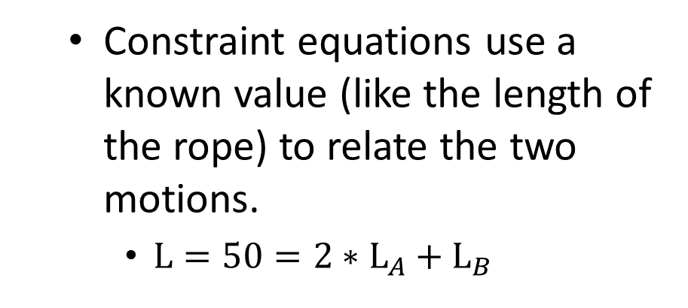
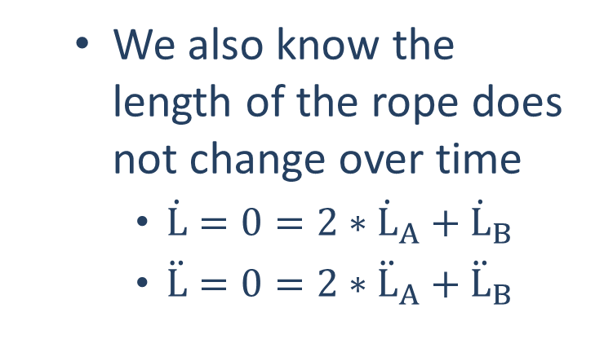
Dependent Motion
Constraint equations use a known value (like the length of the rope) to relate the two motions.
$L=50=2∗L_{A}+L_{B}$
We also know the length of the rope does not change over time
$\dot{L}=0=2∗{\dot{L}}_{A}+{\dot{L}}_{B}$
$\ddot{L}=0=2∗{\ddot{L}}_{A}+{\ddot{L}}_{B}$
L_{A}
L_{B}
20 ft
10 ft

Slide 5
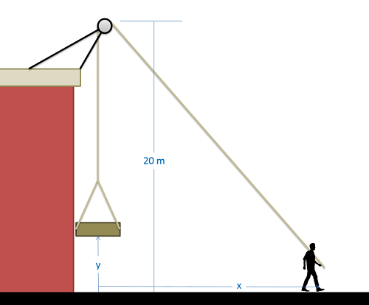
Dependent Motion in 2 Dimensions
In 2 dimensional problems, the process will still start with the constraint equation, relating some known length some key variables
In this case, what would the length of the rope be in terms of x and y?
$$L=40=\left(20−y\right)+\sqrt{{20}^{2}+x^{2}}$$

Slide 6
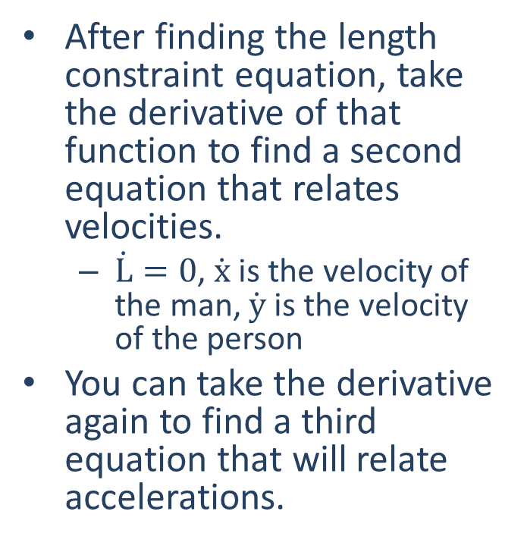
Dependent Motion in 2 Dimensions
After finding the length constraint equation, take the derivative of that function to find a second equation that relates velocities.
$\dot{L}=0$, $\dot{x}$ is the velocity of the man, $\dot{y}$ is the velocity of the person
You can take the derivative again to find a third equation that will relate accelerations.
$$L=40=\left(20−y\right)+\sqrt{{20}^{2}+x^{2}}$$

Slide 7
Thanks for Watching
See other engineering mechanics videos and access the full tool at…

Slide 8
Worked Example
A truck becomes stuck in the sand at a local beach. To help, a friend takes a 50 ft long rope, ties one end to her car, loops the rope around a bar at the front of the truck, and then ties the other end to a stationary tree as shown below. If the car accelerates at a rate of .2 ft/s², what will the velocity of the truck be by the time it gets to the tree?
20 ft
10 ft
B
O
A

Slide 9
Worked Example
A man has hooked up a pulley, a rope, and a platform as shown below to lift loads up onto a nearby rooftop. If x is currently 15 meters, y is currently 5 meters, and the man is walking away from the building at a rate of .5 meters per second, what is the current velocity of the platform?

